Slide 1
MIKE 11
Data Requirements for Model Build

Slide 2
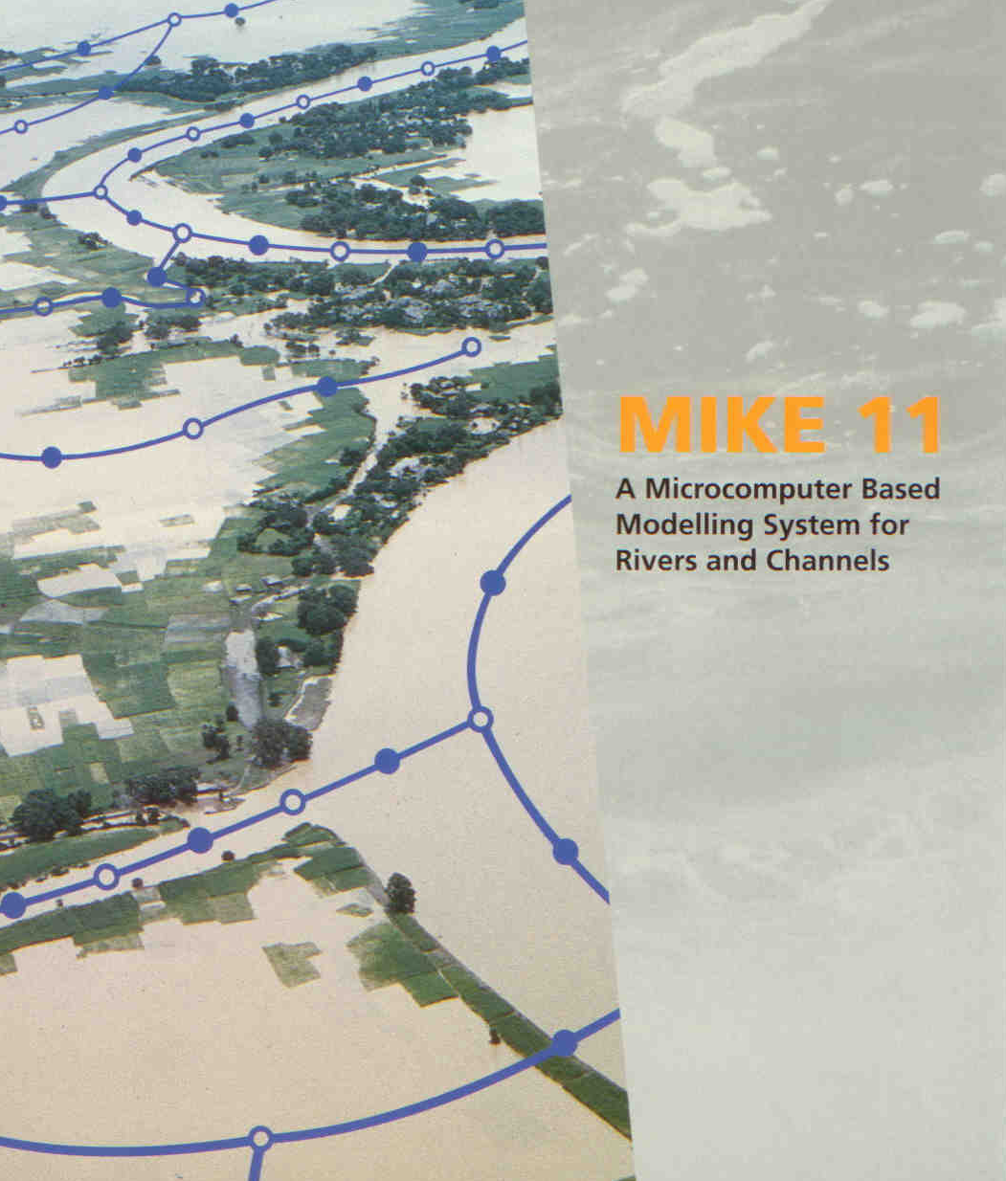
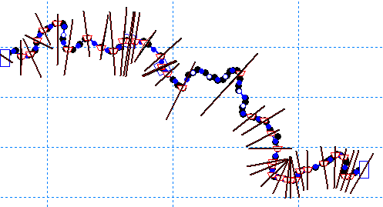
DATA REQUIREMENTS
Data Requirements for Model Build and Application

Slide 3
DATA NEEDS
Model Data Requirements
Solution of Governing Flow Equations Requires Detailed Descriptions of:
Catchment Delineation
River and Floodplain Topography
Hydrometric Data for Boundary Conditions
Hydrometric Data for Calibration / Validation
Man-made Interventions (Structures)
Q
Q
Q
h or Q/h

Slide 4
DATA NEEDS
Model Data Requirements
Reliable Data Required: ‘GARBAGE IN = GARBAGE OUT’
Topographic Data: - Logical Schematization of Model - Survey of Cross-sections and Structures - Aerial/Satellite/Radar images of flood extents - Width, Area, Volume of inundated floodplains. - Reservoir data (control strategy, spillway etc.) - DATUM - Same reference level for all data!
Hydraulic Data: - Stage & Discharge Hydrographs (used for boundary - Rating Curves and Velocity Data conditions and - Peak Water levels during significant events calibration of model) - Anecdotal Flow Behaviour (direction, breakouts)

Slide 5
DATA NEEDS
Model Data Requirements
Topographic Data:
Cross sections, Survey locations:
Where significant changes occur with respect to:
River sections shape
Bed level gradients
River width
Contractions or expansions
Recognized changes in flow dynamics from one section to another
Measure width of sections large enough to ensure all potential flooded part of section is included (rather too wide survey than to narrow)

Slide 6
DATA NEEDS
Model Data Requirements
Topographic Data:
At hydraulic structures:
Survey hydraulic structure. In particular the flow-area of structure (this is entered as structure geometry in MIKE 11)
Up- and down-stream cross sections :
Required to calculate properly the flow through the structure
Optimally surveyed at a distance of 2-5 times the structure flow width upstream and downstream of the structure
Note that for the successful modelling of structures, it is required that cross sections both up- and downstream are (slightly) deeper and larger than the structure for all levels!
If the survey does not show this – then it may be necessary to ‘adjust’ the survey sections to satisfy model requirement: Structures MUST be a Contraction – Expansion feature in the river!!

